Slide 1
VA Healthcare, Eligibility, and Mission Act
Kevin Bowen

Slide 2
Eligibility for Health Care
Veteran Status: established by active duty service and a discharge or released under other than dishonorable conditions
24 Month Rule: Enlisted who served first term of active duty began after September 7, 1980 and commissioned officers & warrant officer who served first term of active duty began after October 16, 1981

Slide 3
Exception to 24-Month Active Duty Rule
Reservists & National Guard who were called to active duty and were granted an other than dishonorable discharge.
Veterans who have a service connected disability.
Veterans for treatment and/or counseling of SMT, treatment for ionizing radiation or nose or throat radium treatment while in the military.

Slide 4
Global War on Terror Veterans
Veterans are eligible for VA Health Care for five years in Priority Group 6 after returning home from combat as an enhanced benefit
Veterans discharged from active duty are eligible to be enrolled in Priority Group 7 or 8 based on income
National Guard and Reserve activated and served in a combat theater of operations are eligible to receive health care benefits if they meet the definition of “veteran” and meet minimum active duty requirements

Slide 5
Enhanced Eligibility
These include:
Medal of Honor recipients
POW’s
Purple Heart Medal recipients
Service connect 10 % or higher
In receipt of VA pension
Hardship discharge
Served in country Vietnam January 9th 1962 to May 7th 1975
Served on ships associated with military service in Vietnam
Served in the Persian Gulf from August 2nd 1990 to November 11th 1998
Camp Lejeune for a minimum of 30 days from August 1st 1953 to December 31st 1987
Catastrophically disabled by the VA
Previous years income is below VA National Income or Geographical-Adjusted Thresholds

Slide 6
Enrollment
Complete a VA Form 10-10EZ
Purple Heart Award Recipient
Former P.O.W.
Served in Combat Theater or Operations after 11/11/1998
Discharged or Retired form Service due to a disability incurred in service
Receiving Disability retirement pay instead of compensation.
Served in SW Asia between 08/02/1990 – 11/11/1998
Service Connected disability from VA
Vietnam Service 01/09/1996 – 05/07/1975
Radiation Exposure
Nose and throat radium treatments
Camp Lejeun 08/01/1953 – 12/31/1987

Slide 7
Enrollment Cont.
Income for household
Gross annual income from Employment
Income from farm, ranch, property or business
Any other income (SS, VA comp, pension, interest, dividends.
Deductible Expenses
Non-reimbursed medical Expenses
Funeral or Burial Expenses
College or Vocational Education expenses (Not dependents’ education expenses)

Slide 8
Income check
https://www.va.gov/healthbenefits/apps/explorer/AnnualIncomeLimits/LegacyGMTThresholds/Index?FiscalYear=2021&PriorityGroupLevel=7&State=SD

Slide 9
Hardship Determination
Income changed from the previous year
Loss of employment
Business bankruptcy
Increase of out-of-pocket medical espenses
Complete 10-10HS
Notes:
When do you fill out a 10-10HS?
must complete a 10-10EZ and be denied

Slide 10
Additional Services
Hearing Aids
Eye Glasses
Chiropractic Care
Notes:
When chiropractic care is not offered on site at local VA, Chiropractic care is available through non-VA care or Care in the Community

Slide 11
VA Mission Act
Expanding Benefits for Caregivers
Community Care
Urgent Care

Slide 12
Expanding Benefits for Caregivers
Eligibility:
Family caregivers of Veterans who were seriously injured in the line of duty on or after September 11, 2001.
Mission Act (Applications accepted starting October 1, 2020):
Family caregivers of Veterans who were seriously injured in the line of duty on or before May 7, 1975.
After 2 years, Family caregivers of Veterans who were seriously injured in the line of duty between May 7, 1975, and September 10,2001, will become eligible
Notes:
Veteran must have a single or combined service-connected disability retain by the VA of 70% or more. This requirement is included in the definition of “serious injury” and be in need of personal care services (requiring in-person personal care services) for a minimum of six continuous months based on the inability to perform an ADL (activity of daily living) or a need for supervision, protection, or instruction.

Slide 13
Expanding Benefits for Caregivers
Primary and Secondary Family Caregivers can receive:
Caregiver education and training
Mental health counseling
Travel, lodging, and financial assistance when traveling with the Veteran to receive care.
Primary Family Caregivers
A monthly stipend
Access to health care benefits though CHAMPVA
At least 30 days per year of respite care for the Veteran
Notes:
Veteran can appoint 2 Caregivers (primary and secondary)

Slide 14
Monthly Stipend for Caregiver
Stipend amounts would be based on the Office of Personnel Management (OPM) General Schedule Annual Rate for grade 4, step 1, based on the locality pay area in which the eligible Veteran resides. Because VA provides a monthly stipend, the annual rate would be divided by 12. VA would refer to this amount as the “monthly stipend rate.” VA is proposing the following two stipend payment amounts based on the eligible Veteran’s needed level of care:
a. Level 2: For an eligible Veteran who is determined to be unable to self-sustain in the community, the stipend amount would be 100% of the monthly stipend rate. For example, the GS rate at grade 4, step 1 in Dallas, Texas for 2020 is $33,638 annually. Thus, the 2020 monthly stipend amount for a Primary Family Caregiver of an eligible Veteran in Dallas, Texas at this rate would be approximately $2,803.17.
b. Level 1: For an eligible Veteran who is not determined to be unable to self-sustain in the community, the stipend amount would be 62.5% of the monthly stipend rate. For example, the 2020 monthly stipend amount for a Primary Family Caregiver of an eligible Veteran in Dallas, Texas at this rate would be approximately $1,751.98.
Notes:
GS payscale for GS-4 in SD is $31,520
Level 2: $31,520 annually or $2,626 per month
Level 1: $19,700 annually ; $1,641 per month.

Slide 15
How to Apply for Family Caregiver Program
Complete VA Form 10-10CG

Slide 16
Care in the Community
Eligibility for Care in the Community
Veteran must be enrolled
Receive approval from VA
Notes:
The veteran must be enrolled in VA healthcare
Veterans must receive approval from VA prior to obtain care from a community provider, in most circumstances

Slide 17
Care in the Community
Appointments
Veteran has to go through VA primary care provider
Choose between VA medical facility or community provider
Veteran chooses community provider VA will make the appointment
Notes:
Veterans eligible for community care generally have the option of choosing to receive care from a VA medical facility or community provider.

Slide 18
Care in the Community
Finding a Community Provider
Veteran can choose provider
VA will help choose
Notes:
Veterans can choose their preferred community provider or VA staff member can help select one. Now keep in mind the selected community provider must be part of the VA’s provider network.

Slide 19
Care in the Community
Network Providers
https://www.va.gov/find-locations/
Notes:
Find a VA location or in-network community care provider. For same-day care for minor illnesses or injuries, select Urgent care for facility type.

Slide 20
Care in the Community
Scheduling Appointments
Directly schedule an appointment and inform a VA staff member about the appointment
Use VA Online Scheduling to request an appointment for certain types of routine services
Have a VA staff member schedule the appointment
Have VA's Third Party Administrator (TPA) schedule the appointment
Notes:
Before scheduling an appointment, it is important for the Veteran to confirm with a VA staff member that they are eligible and authorized for community care.
Once authorized to receive community care, they have several options for scheduling an appointment with a community provider, depending on the type of care they need. A Veteran may be able to:
Directly schedule an appointment and inform a VA staff member about the appointment
Use VA Online Scheduling to request an appointment for certain types of routine services
Have a VA staff member schedule the appointment
Have VA's Third Party Administrator (TPA) schedule the appointment
VA will send the Veteran and the selected community provider a referral. VA will also send the Veteran's medical documentation to the community provider to ensure proper care coordination between their VA care team and the community provider.

Slide 21
Care in the Community
Getting Care
Surgery
Prescription Medication
Notes:
Getting Care
When a Veteran arrives for the appointment, the community provider should have the appointment, VA referral, and medical documentation on file. If a Veteran needs a follow-up appointment, the community provider should check to make sure VA has authorized additional care before scheduling the appointment.
Surgery
Prior to undergoing surgery at a community provider facility, Veterans and their family members may access information about the surgeon performing the surgery. Information required to be available includes the surgeon’s education, training, licensure, registration, and certification by the authorizing state and national entity.
Prescription Medication
If prescription medication is needed, the prescription should usually be sent to and filled by the nearest VA pharmacy. Veterans can receive short-term prescription medication for a 14-day or fewer supply that can be filled at a non-VA pharmacy. A prescription for more than a 14-day supply must be filled by VA.
Urgent care:

Slide 22
Care in the Community
Billing and Payments
Community providers cannot bill or collect from veteran
Veteran may have to pay VA for copays on priority group or nonservice-connected conditions
VA may also bill veteran’s insurance companies for nonservice-connected conditions
Notes:
After receiving care from a community provider, Veterans may have to pay a copayment for nonservice-connected care, just as the Veteran would if care was received at a VA medical facility. For urgent care, copayments depend on the Veteran's assigned priority group and the number of times the Veteran visits an urgent care provider in a calendar year.
Community providers cannot bill or collect a VA copayment directly from Veterans, including for urgent care. All VA copayments are billed as part of VA’s billing process.
VA may also bill insurance companies for care that is nonservice-connected. More information about VA Veteran copayments and health insurance is available in the links below:

Slide 23
Care in the Community
Urgent Care
To access an in-network urgent care provider, you must:
Be eligible.
Go to an in-network urgent care provider.
Pay a VA copayment (if applicable) after the visit, which is billed separately by VA.
To find an in-network pharmacy:
Use the VA Facility Locator to locate in-network pharmacy locations
Notes:
Urgent Care
VA offers urgent care services to eligible Veterans at VA medical facilities or at in‑network urgent care clinics closer to home.
Use VA’s urgent care benefit to treat minor injuries and illnesses that are not life-threatening, such as colds, strep throat, sprained muscles, and skin and ear infections.
*BEFORE YOU GO!
Print the Urgent Care Assistance Card (or have it viewable on your mobile device) and take it with you to your urgent care visit and in-network pharmacy. When using the card, identify the correct region where you are seeking care.

Slide 24
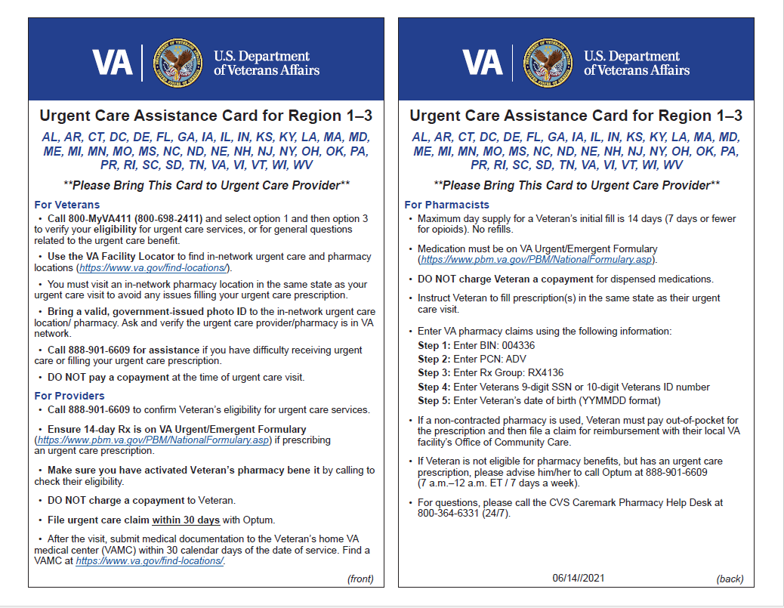
Care in the Community
Urgent Care

Slide 25
Questions
Notes:
I know that I didn’t talk about priority groups or the co-pays to the VA, but I really wanted to cover a little more on the care givers, care in the community and urgent care.

